Slide 1
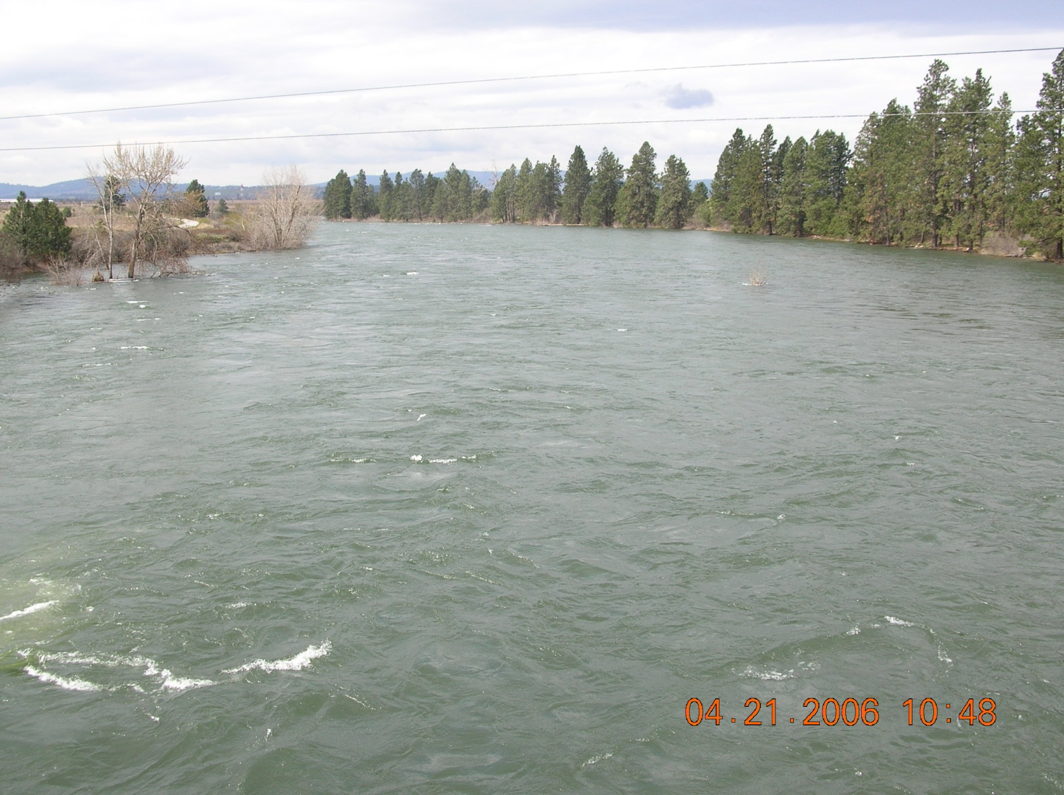
Instream Flows in the Spokane River
Guy J. Gregory
Washington Dept. of Ecology
Water Resources Program
Harvard Rd. Downstream
4/21/2006
19,200 cfs @ Post Falls

Slide 2
Why now?
We’ve got the science now.
Avista 401 process
WRIA process
Post 401 process
We’ve got the people now.
Most WRIA participants and informed people are still here
Rule development staff within Ecology are here and experienced
10 years of outreach = an informed public
We’ve got the authority now.
RCW 90.22, RCW 90.54
We’ve got an incipient water resource problem now.

Slide 3
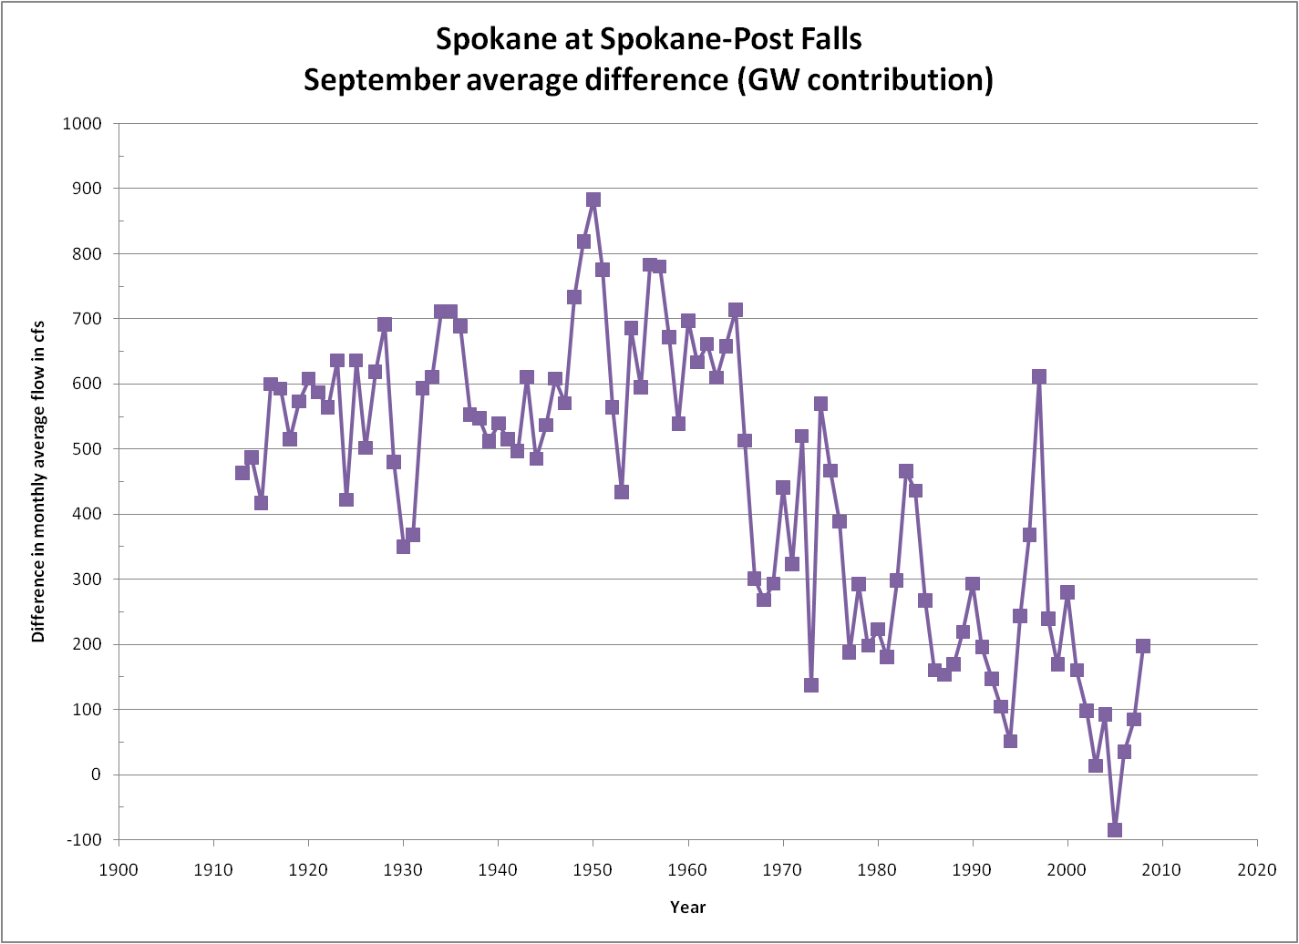

Slide 4
The language of in-stream values
Minimum Flows
specific flows to protect specific values: fish habitat, recreation, aesthetics
Federal Energy Regulatory Commission and Clean Water Act section 401 certification
Minimum flows for operation of hydropower system
Instream Flows
specific flows to protect specific values: fish habitat, recreation, aesthetics
Idaho Water Resource Board, WRIA Planning units
RCW 90.22, 90.54
a “Water Right for the River”

Slide 5
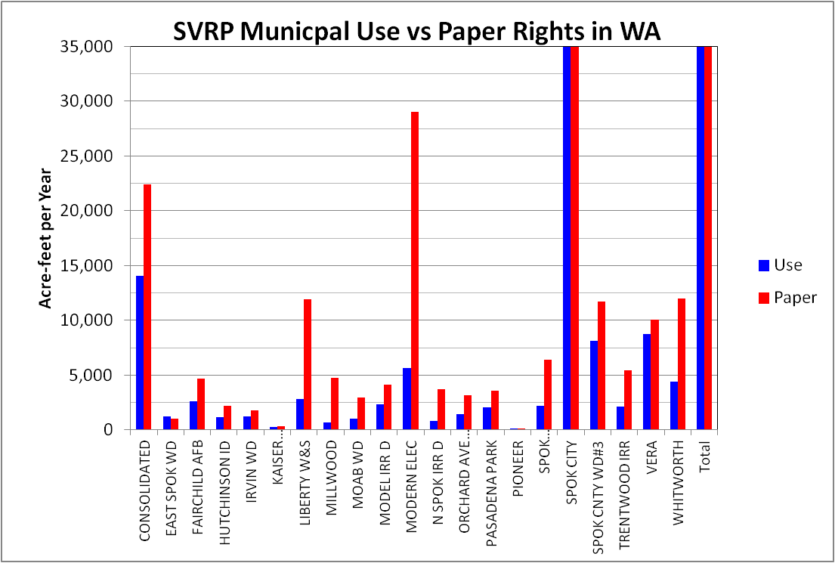
About water rights…

Slide 7
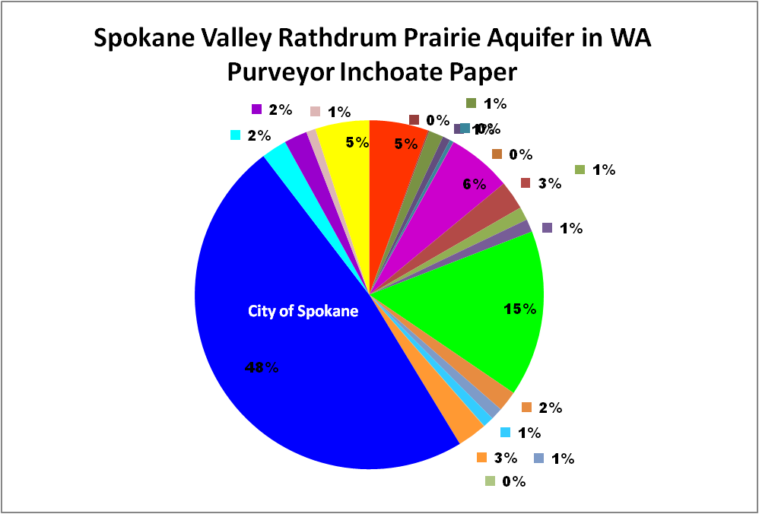

Slide 8
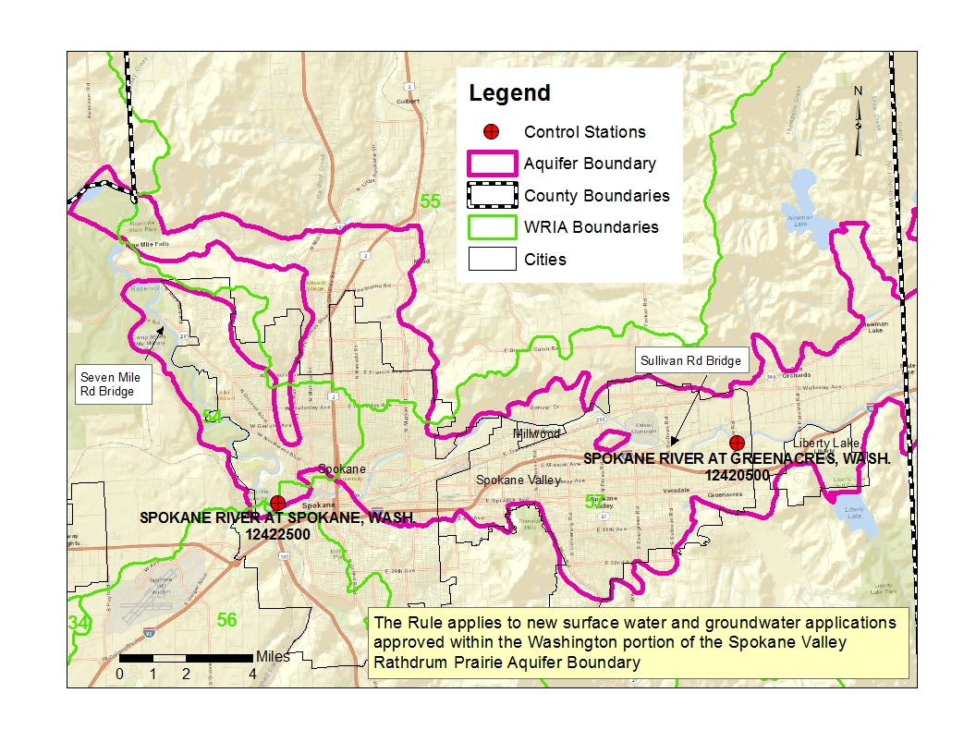
Where would the rule apply?

Slide 9
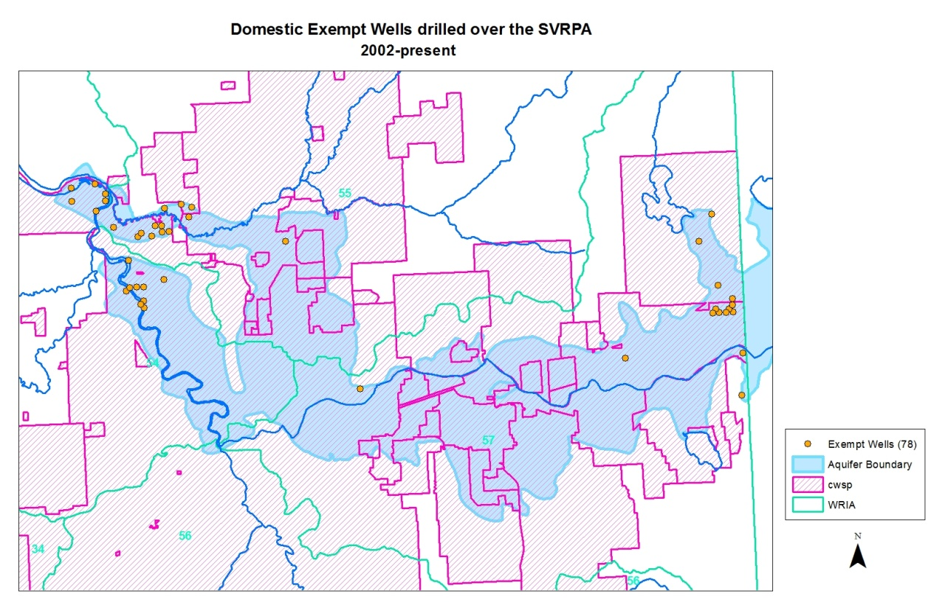
What about exempts?

Slide 10
State Caucus Recommended Minimum Instream Flows at the Spokane Gage
October 1-March 31 1,100 cfs
April 1-June 15 6,500 cfs
June 16-September 30 850 cfs

Slide 11
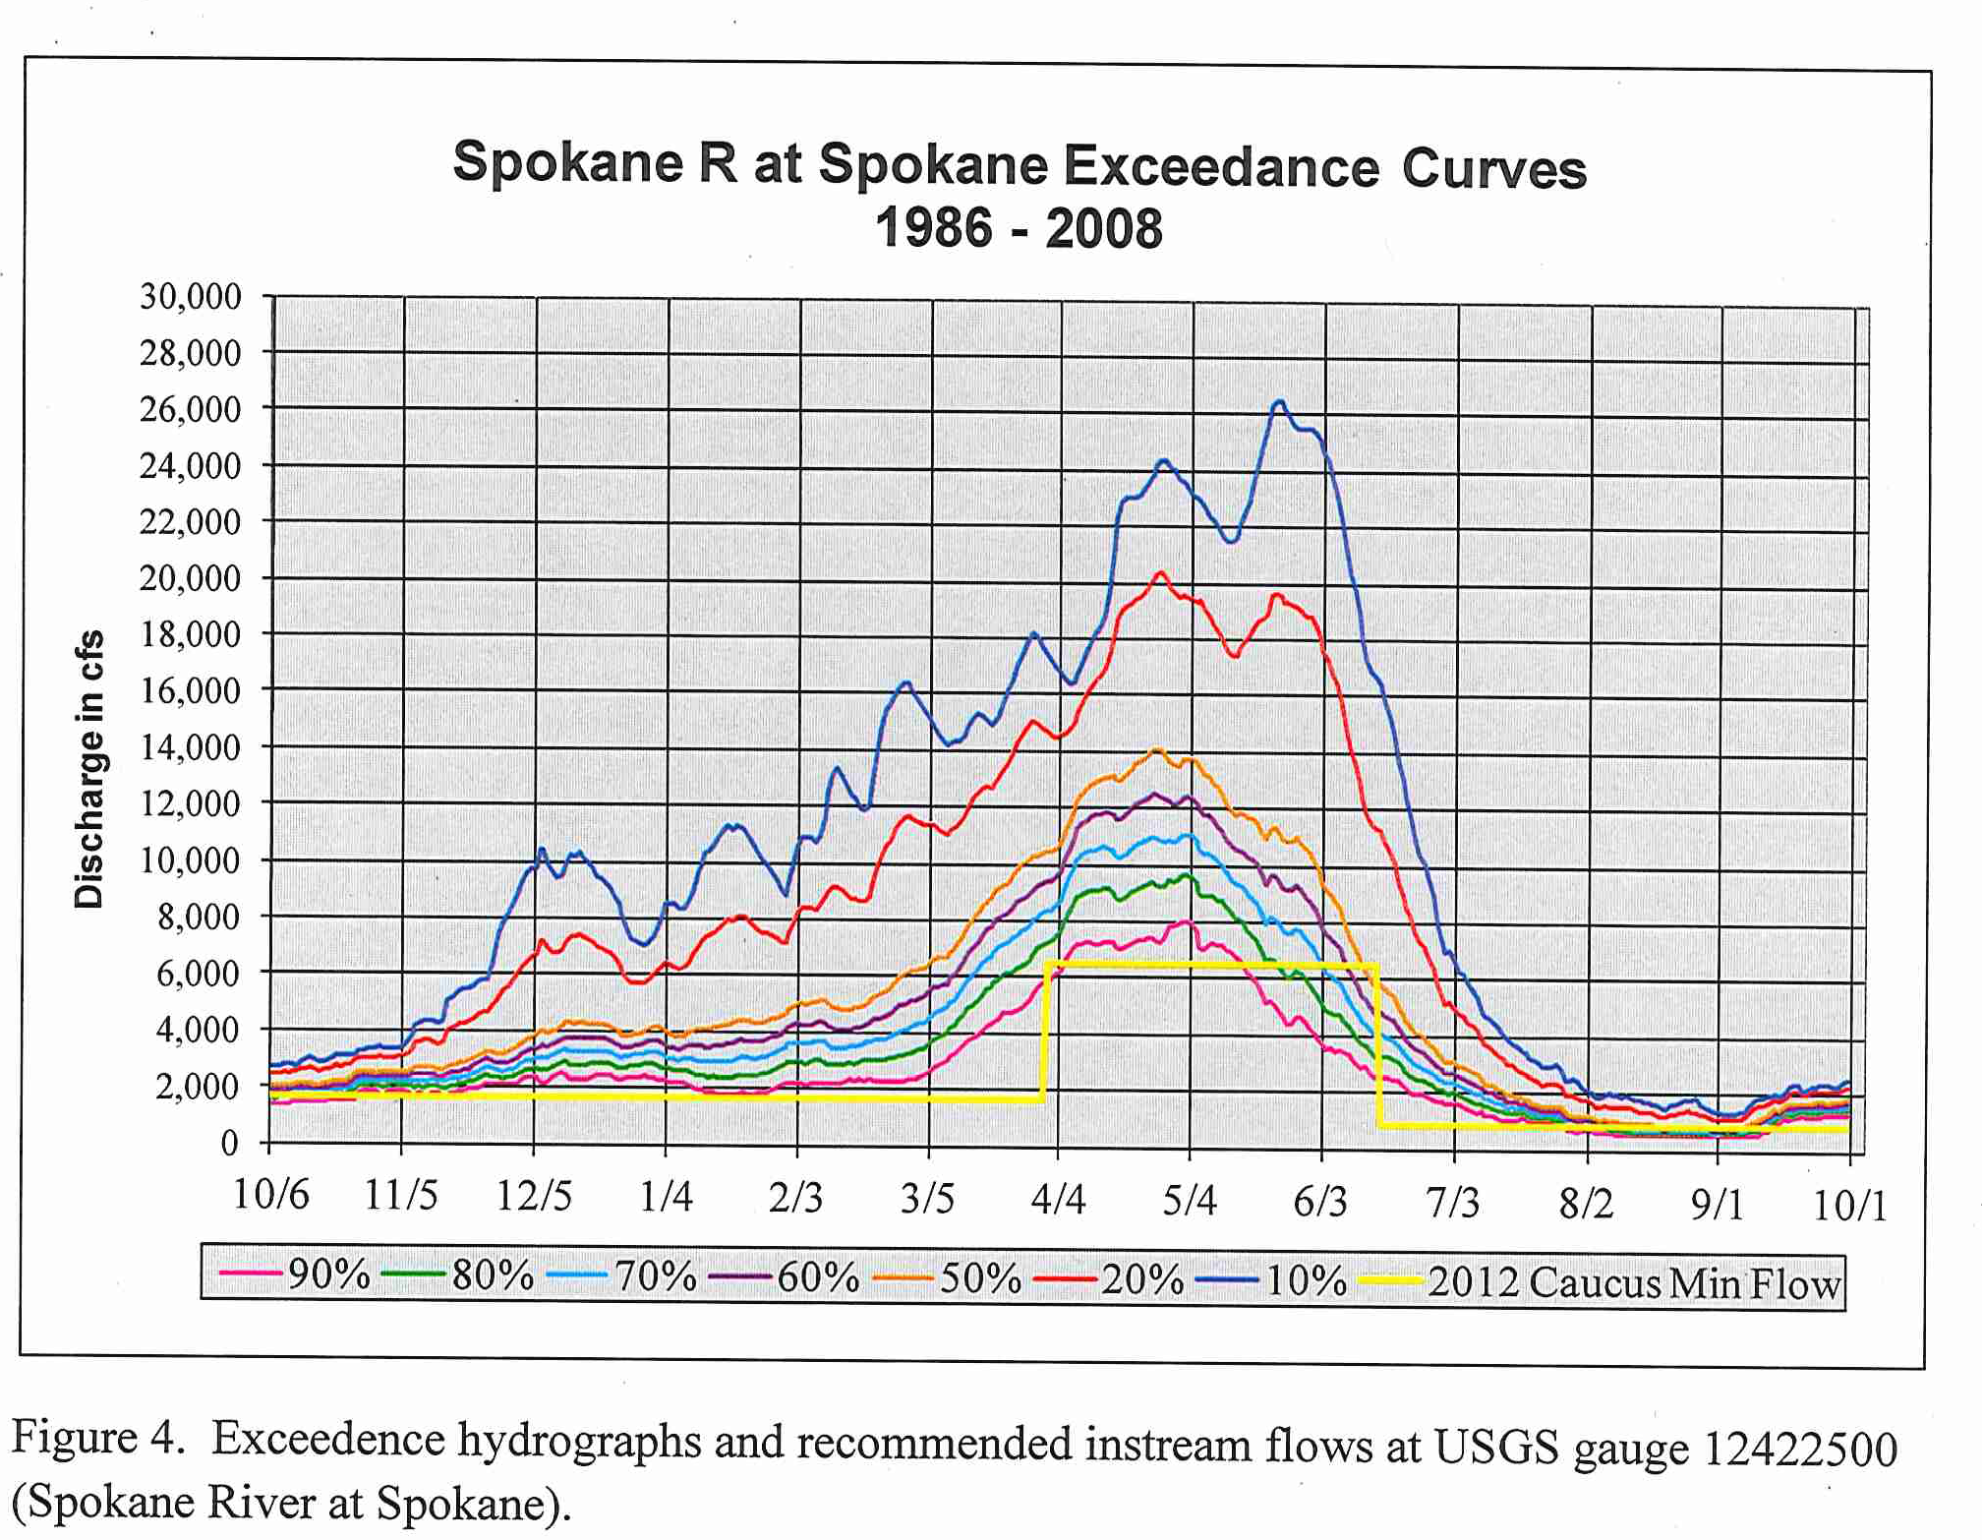
How do proposed flows relate to river flow now?

Slide 12
Timing
Senior Management Approval – Mid-July, 2013
First notice: CR-101 – August 1, 2013
Internal Proposed Rule Language – October 2013
Public process begins: CR-102 – January 2014
Rule language final:CR-103 – June 2014
Rule Adoption

Slide 13
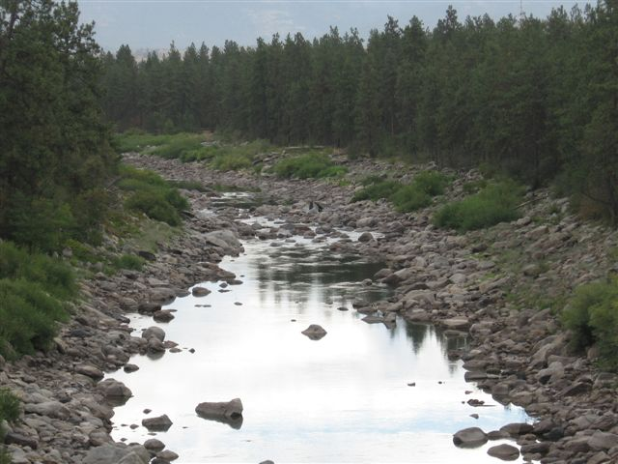
Thank you!
Guy Gregory
WDOE Eastern Region
509-939-1052
guy.gregory@ecy.wa.gov
Spokane River upstream from Sullivan Rd. Bridge
8/31/2009
327 cfs @ Post Falls

